Slide 1
I Wanna Be the Guy
Mauricio carazas segovia

Slide 2
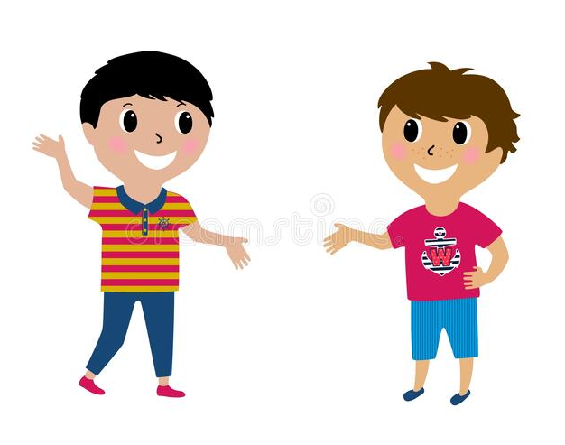
There is a game called "I Wanna Be the Guy", consisting of n levels. Little X and his friend Little Y are addicted to the game. Each of them wants to pass the whole game.

Slide 3
Little X can pass only p levels of the game. And Little Y can pass only q levels of the game. You are given the indices of levels Little X can pass and the indices of levels Little Y can pass. Will Little X and Little Y pass the whole game, if they cooperate each other?
X -> p levels
Y -> q levels

Slide 4
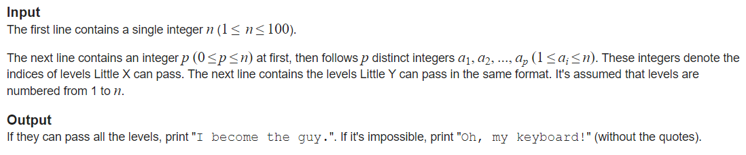

Slide 5
n, donde 1<=n<=100
Para n = 5
1
2
3
4
5
p= 3
1,2,3
q= 3
3,4,5
I become the guy.

Slide 6
n, donde 1<=n<=100
Para n = 4
1
2
3
4
p= 3
1,2,3
q= 2
1,2
Oh, my keyboard!

Slide 7
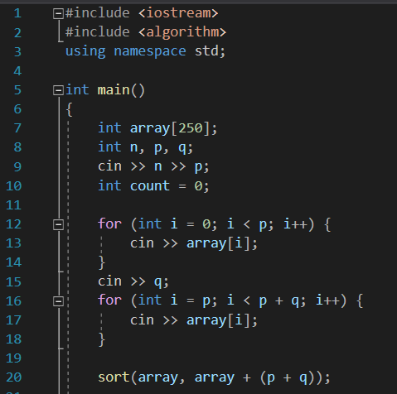

Slide 8
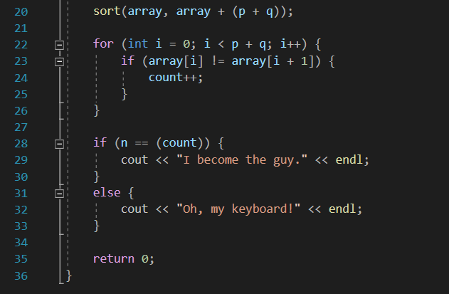

Slide 9
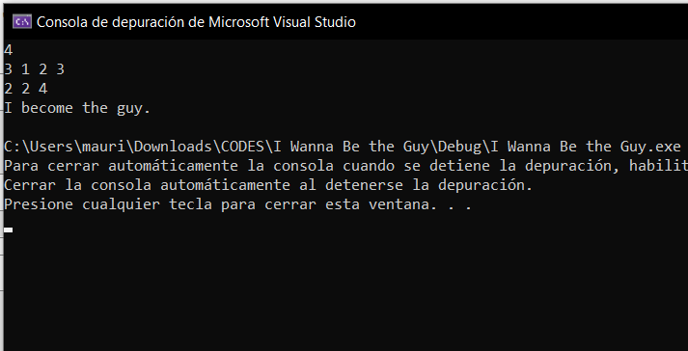

Slide 10
